Slide 1
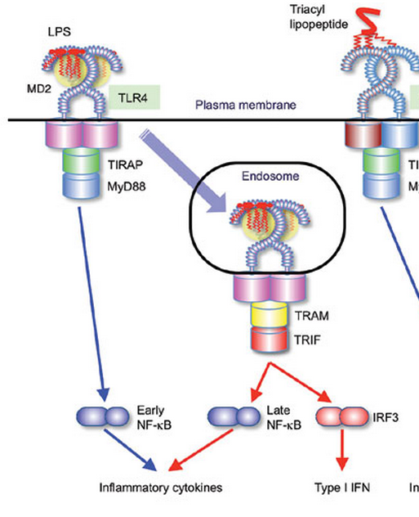
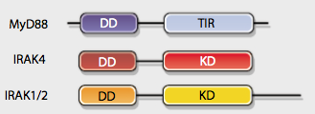
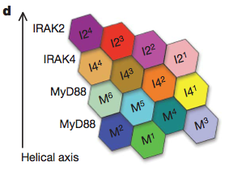
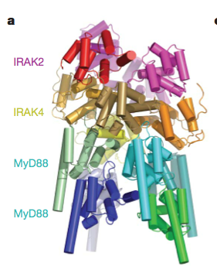
TLR4 is special
Spatial
Topological
Structural
Dynamical features in the sub-pathways (quantitatively)
Molecular details in shaping the dynamics

Slide 2
Current conclusions and/or hypothesis:
Dynamical features in the sub-pathways (prediction):
MyD88 sub-pathway determine the response speed.
TRIF sub-pathway determine the response duration(linearly increase to log dose).
Will strengthen by single cell data (first peak, duration, integral)
Molecular details in shaping the dynamics (MyD88):
Myddosome formation produce threshold in signaling activation
The ligand induced-shuttling is responsible for the duration specificity
Threshold provides switch-like first peak behavior
Stochasticity happens at the level of sub-pathway activation can explain single cell data
Stochastic activation in Trif alone can generate two clusters heterogeneous post-first-peak behavior (very stochastic, due to endocytosis??)
But the stochasticity in MyD88 will bring in viability in response speed (very robust)
Notes:
Conclusions:

Slide 3
The TLR4 model diagram
3 compartments
41 species
100 Reactions
Notes:
Need reaction maps.

Slide 4
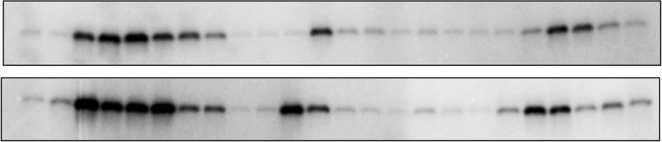
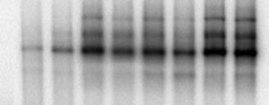
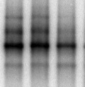
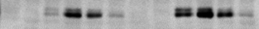
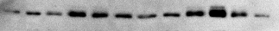
Model validation and experimental data
B
WT
trif ^{- /-}
myd88^{- / -}
LPS
15
120
120
120
min
30
45
60
90
15
30
45
60
90
15
30
45
60
0
90
5
0
5
0
5
1 ng/ml
IKK
100ng/ml
1 ng/ml LPS
100 ng/ml LPS
120
min
240
120
10
30
60
10
240
0
30
60
NF-κB_{n}
1 ng/ml LPS
100 ng/ml LPS
0
10
30
60
120
240
0
10
30
60
120
240
min
IRF3_{np}
IRF3_{n}
C
D
IKK
NFκBn
0.8
wt exp.
0.8
wt sim.
0.4
0.4
0
0
20
40
60
80
100
120
0
Level (Normalized to maximum)
Level (Normalized to maximum)
Time (min)
0
30
60
90
120
150
180
210
240
0.6
IRF3_{np}
0.8
wt exp.
0.4
wt sim.
0.2
0.4
0
0
20
40
60
80
100
120
0
0
30
60
90
120
150
180
210
240
Time (min)
Time (min)
Red: 100 ng/ml LPS; Blue: 1 ng/ml LPS
Red: 100 ng/ml LPS; Blue: 1 ng/ml LPS
wt exp.
wt sim.
mko exp.
mko sim.
tko exp.
tko sim.
Diana
Notes:
Always to question about how big your parameter space is. And how robustness about the parameter set.

Slide 5
Challenge: Fit the mean behavior of single cell data for first 4 hours
Change as little as possible (find key parameters)
NFkB module
Negative feedback is the key
Mean of single cell trajectories
EMSA data and simulations
Two peaks

Slide 6
The NFkB module is trending to be oscillation.
NFkBn
IKK flux
Output
Input
Time (min)
Time (min)
Notes:
The NFkB module is trending to be oscillation.

Slide 7

To capture the variability in single cell data
f_{m}
MyD88
MyD88*
f_{t}
TRIF
TRIF*
+
Another key parameter
Randomize those parameters
(log-normal distribution or other)

Slide 8
Diminish the oscillation: I increased the IKK flux by a modifier

Slide 9
Diminish the oscillation: I increased the IKK flux by a modifier
trif ko

Slide 10
Dynamics features in sub-pathways: duration, responsive speed
A
B
Both
TRIF pathway
MyD88 pathway
Similar response slope
C
D
Overlap response speed
Notes:
Similar response slop

Slide 11
Myddosome formation produce kinetic threshold in signaling activation (1)
Input
Output
MyDDosome model
dM/dt <- -2*k1*C*M + 2*k_1*CM2 + 6*kd*M6
dC/dt <- k_1*CM2-k1*C*M + 3*k4*C3M6
dCM2/dt <- k1*C*M - k_1*CM2- 2*k2*CM2^2- k3*CM2*C2M4
dC2M4/dt <- k2*CM2^2- k3*CM2*C2M4
dC3M6/dt <- k3*C2M4*CM2 - k4*C3M6
dM6/dt <- k4*C3M6 – k5*M6
k1=kf,k_1=kb,k2=kf,k3=kf,k4=kf,k5=kb
kf=1,kb=0.1
M0=10,C0=from 0 to 10
Notes:
Input

Slide 12
Myddosome formation produce kinetic threshold in signaling activation (2)
A
0.8
0.6
6*M^{ss}₆/M₀
0.4
0.2
Threshold
0
0
0.2
0.4
0.6
0.8
1
C₀/M₀
6*M^{ss}₆/M₀
B
10
0.8
8
0.6
6
k_{f}/k_{b}
0.4
4
2
0.2
0
0
0
0.2
0.4
0.6
0.8
1
C₀/M₀
Notes:
Input

Slide 13
The kinetic threshold in MyD88 activation produce the switch-like behavior in the first peak
n = 3.2
n = 2

Slide 14
What’s next?
TNF
CpG
LPS
dsRNA
TNFR
TLR9
TLR4
TLR3
Werner et al
G&D 2008
MyD88
TRIF
IKK
TBK
TNF
Production
Werner et al
Science 2005
NF-κB
IRF3
TNF
With Andrew
κB
Notes:
Why TNF? Ask Andrew. – Tumor necrosis factor

Slide 15
Part 1: TNF production module

Slide 16
Module1 : Transcription + RNA processing
LPS
RNA processing
TRIF*
MyD88*
NFκB
Output
Input
Transcription, f(NFkB)
TNF
κB
Equation
Initial condition
Parameters (n_{p}= 5)

Slide 17
Score function (modified chi square)
Table of features (n_{F}=9)
Index(i) | Feature | Value(F^{e}_{i}) | Error(σ_{i})
1 | Peak time (wt) | 30 min | 5 min
2 | Peak time (mko) | 60 min | 10 min
3 | Peak time (tko) | 30 min | 5 min
4 | Peak_wt/Peak_mko | 0.68 | 0.11
5 | Peak_wt/peak_tko | 0.75 | 0.22
6 | Wt(60)/tko(60) | 1.55 | 0.67
7 | Wt(60)/mko(60) | 0.59 | 0.07
8 | Wt(120)/mko(120) | 0.52 | 0.21
9 | Wt(120)/tko(120) | 1.49 | 0.43
Notes:
http://en.wikipedia.org/wiki/Goodness_of_fit; chi_square <1:indicates that the model is 'over-fitting' the data (either the model is improperly fitting noise, or the error variance has been overestimated).
Chi_square >1: indicates that the fit has not fully captured the data (or that the error variance has been underestimated).
Chi_square =1:extent of the match between observations and estimates is in accord with the error variance.

Slide 18
Module 2: RNA processing + stabilization
Output
LPS
RNA processing
TRIF*
MyD88*
Input
Equation
Initial condition
Parameters (n_{p}= 5)
Notes:
6 fold less in MyD88 ko

Slide 19
Score function (modified chi square)
Table of features (n_{F}=7)
Index(i) | Feature | Value(F^{s}_{i}) | Error(σ_{i})
1 | Peak time (wt) | 60 min | 10 min
2 | Peak time (mko) | 60 min | 10 min
3 | Peak time (tko) | 60 min | 10 min
4 | Peak_tko/Peak_wt | 0.73 | 0.05
5 | Peak_mko/peak_tko | 0.50 | 0.06
6 | wt_120/mko_120 | 1.98 | 0.23
7 | Wt_120/tko_120 | 1.17 | 0.14

Slide 20
How well the model capture the features.
Score heat map for processing rate in different genotypes
Nascent fit score
mRNA fit score
Notes:
Nascent fit score

Slide 21
Module 3: Translation + Secretion
Output (1)* TACEi
Secretion
Output (2)
Translation
LPS
Input
TRIF*
MyD88*
Notes:
proTNF half-life: less than 15 mins;
J Immunol. 1997 Nov 1;159(9):4524-31.
The fate of pro-TNF-alpha following inhibition of metalloprotease-dependent processing to soluble TNF-alpha in human monocytes.
Solomon KA, Covington MB, DeCicco CP, Newton RC.

Slide 22
Index(i) | Feature | Value(F^{s}_{i}) | Error(σ_{i})
1 | Peak time (wt) | 60 min | 10 min
2 | Peak time (mko) | 60 min | 10 min
3 | Peak time (tko) | 60 min | 10 min
4 | Peak_tko/Peak_wt | 0.34 | 0.06
5 | Peak_mko/peak_tko | 0.82 | 0.14
6 | wt_120/Peak_wt | 0.20 | 0.04
7 | Wt_120/tko_120 | 3.9 | 0.65
8 | wt_120/mko_120 | 14 | 2.3
9 | Tko_30/mko_30 | 0.75 | 0.12
Index(i) | Feature | Value(F^{s}_{i}) | Error(σ_{i})
1 | tko_60/wt_60 | 0.17 | 0.03
2 | Mko_60/tko_60 | 1.4 | 0.54
3 | Tko_120/wt_120 | 0.17 | 0.03
4 | Mko_120/tko_120 | 1.9 | 0.76
5 | wt_120/wt_60 | 1.2 | 0.16
Notes:
f(NFkB)

Slide 23
How well the model capture the features.
Score heat map for different parameters.

Slide 24
Module 1 to 3, together (NFkB as input, 4 outputs)
ID | Name | Values
1 | Kd_tr | 0.65
2 | Kd_tr_fold | 2
3 | V_tr | 1
4 | k_pr | 0.4
5 | k_sec | 0.07
6 | k_tl | 0.05
7 | kdeg_m | 0.02
8 | kdeg_p | 0.07
9 | n | 2
10 | pr_fold_mko | 4.2
11 | pr_fold_tko | 1.5
12 | sec_fold | 5
13 | tl_fold | 1.5
Secretion
LPS
TLR4 module
Translation
TRIF*
MyD88*
RNA processing
NFκB module
NFκB
Transcription, f(NFkB)
TNF
κB

Slide 25
Module 1 to 3, together (NFkB as input, 4 outputs)
ID | Name | Values
1 | Kd_tr | 0.65
2 | Kd_tr_fold | 2
3 | V_tr | 1
4 | k_pr | 0.4
5 | k_sec | 0.07
6 | k_tl | 0.05
7 | kdeg_m | 0.02
8 | kdeg_p | 0.07
9 | n | 2
10 | pr_fold_mko | 4.2
11 | pr_fold_tko | 1.5
12 | sec_fold | 5
13 | tl_fold | 1.5
Notes:
Explain why can fit

Slide 26
Part 2: Linking all modules together

Slide 27
Secretion
CpG
dsRNA
LPS
p
ERK
TT
TLR module
Translation
TNFR module
TRIF*
MyD88*
p
P38
IKK module
RNA processing
IKK
NFκB module
NFκB
Transcription, f(NFkB)
TNF
κB

Slide 28
Secretion
dsRNA
CpG
LPS
TT
TLR module
Translation
TNFR module
TRIF*
MyD88*
IKK module
RNA processing
IKK
NFκB module
NFκB
Transcription, f(NFkB)
TNF
κB

Slide 29
Secretion
LPS
TT
TLR module
Translation
TNFR module
TRIF*
MyD88*
IKK module
RNA processing
IKK
NFκB module
NFκB
Transcription, f(NFkB)
TNF
κB

Slide 30
Linking with TLR4 model (LPS as input)
TNF feedback contribute to the 60mins -120mins activity in myd88 pathway but not trif
Dashed lines: without TNF feedback
Solid lines: with TNF feedback
Notes:
Two ways of match mRNA and nascent profiles:
Increase the contribution of TNF feedback to the tko late phase
Adjust the NFkB threshold changes in the mko with processing rate changes in mko.
Dashed lines: without TNF feedback

Slide 31
TNF feedback contribute to myd88 pathway but not trif
Validate by CpG and PIC stimulation (1)
Notes:
TNFr synthesis

Slide 32
TNF feedback contribute to myd88 pathway but not trif
Validate by CpG and PIC stimulation (2)

Slide 33
Summary for this project.
1. Cytokine production is tightly regulated at different molecular level.
We constructed the mathematical model in each module.
We also tested different regulation mechanisms by the model.
We linked all the modules together.
We linked all the modules with TLR4 model (but seems not match trif ko late phase for the NFkB activity, why?).
2. TNF feedback is critical in determining stimulus specificity in the TLR signaling.
Linking TLR4 model + TNF production model + TNF receptor model can capture all the data, suggesting the TNF feedback is more important in MyD88 mediated signaling.
Testing this idea, by studying CpG and PIC, which are mediated by MyD88 and TRIF respectively.
We see big difference in CpG responses but not PIC (readouts: TNF mRNA and Elisa). Adding CpG and PIC module into the big model confirms the difference.
The big model also suggested upstream NFkB should also see the same result
We tested in NFkB activity
Lastly, functional study (image and RNAseq)

